Slide 1
Property price
Data analyst by
Darpan Sarode

Slide 2
Introduction
It is a Property Price Dataset to Analyze the and Derive the Result and take the Business Solutions.
Property Price Dataset has 81 columns and 1459 Rows in Train and same as Test dataset having columns is 80
Some of them are categorical columns and some of the are numerical Columns.
Target variable has Numerical columns.
Analysis the data and visualize the result in form of Graphs

Slide 3
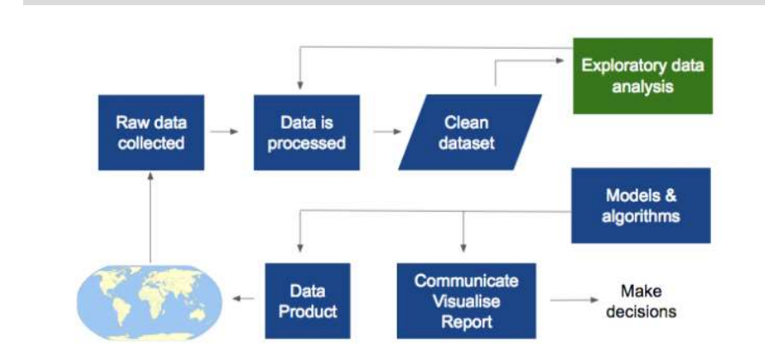
Work Flow

Slide 4
Procedural Features
Import Required Library Functions To Notebook
Read a Dataset
Clean the Data and required to numerical formats.
Transform the Data
Use predictive ML alogotithum to predict required Values.
Calculate Mean Square Error and Its Accuracy.
Visualise the Result with The help of Matplotlib or other Tools such as Tabelue

Slide 5
Procedural Steps
Removing Null Values
Checking Skewness if present more the reduced it.
Outlier Treatment.
Model Use

Slide 6
R SQUARE|ADJESTED R SQUARE | MAPE & Accuracy
Target variable is Numerical so better to go the Linear Model.
R2 =0.8518615326196568
AdjR2=0.8452823170196702
MAPE=11.0458848074672
Accuracy=88.9541151925328

Slide 7
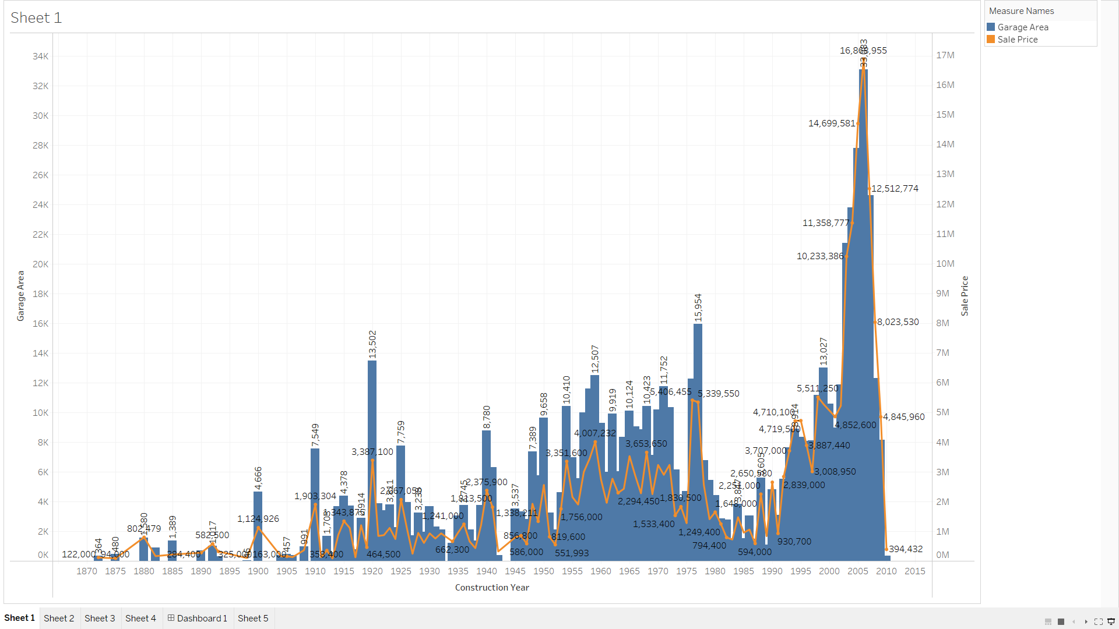
Visualize Results

Slide 8
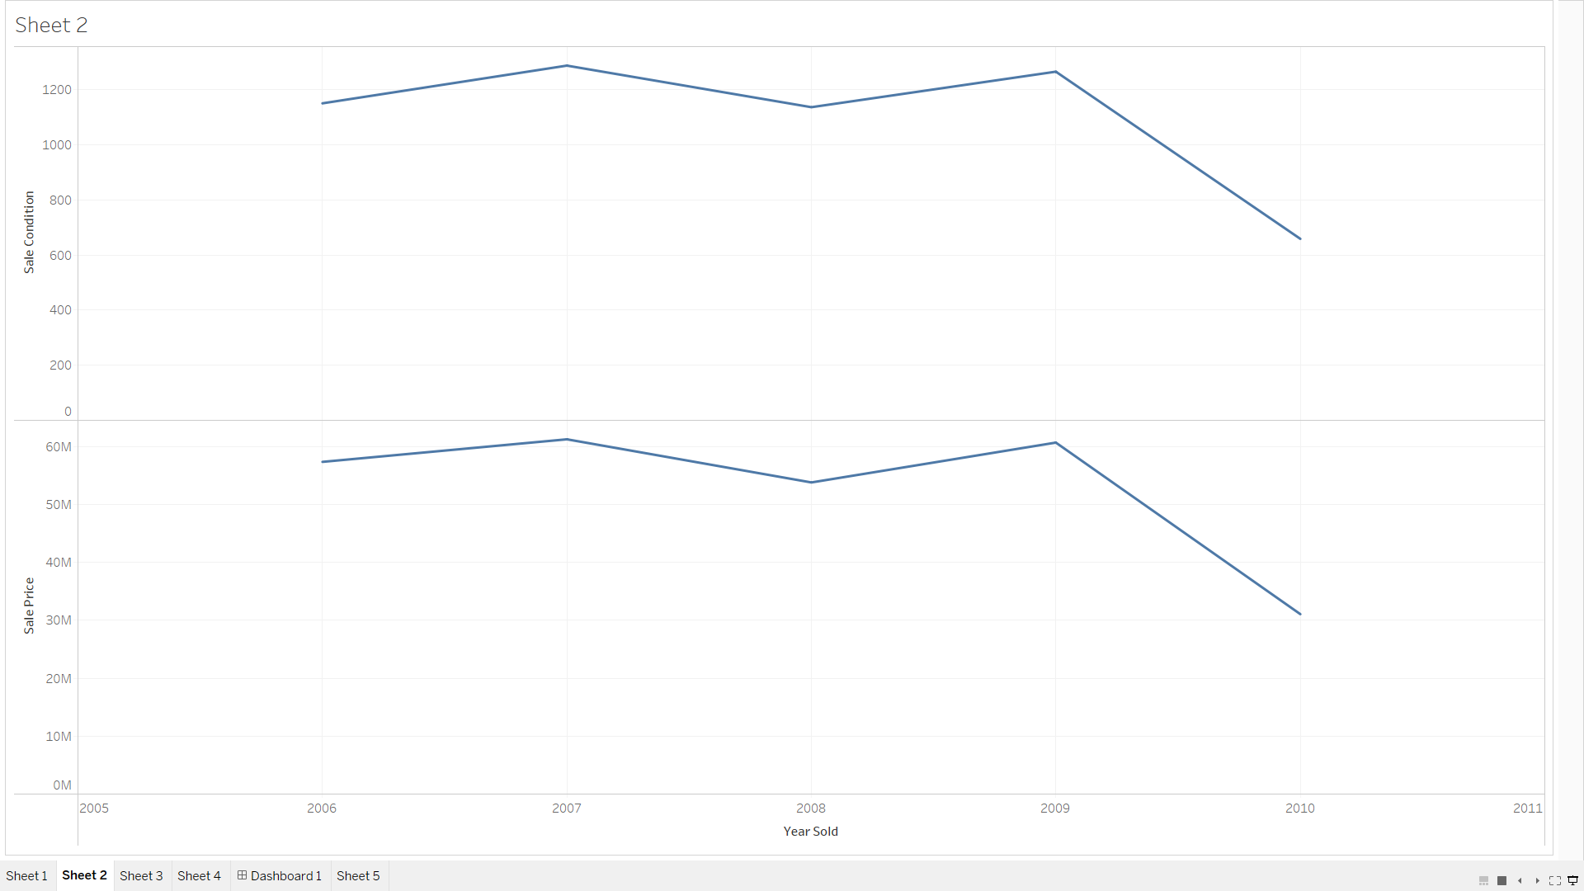

Slide 9
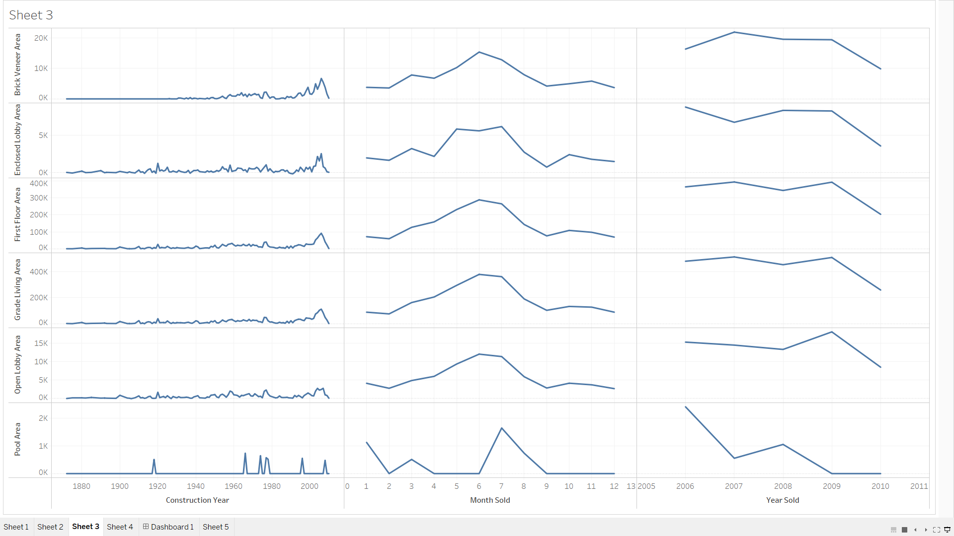

Slide 10
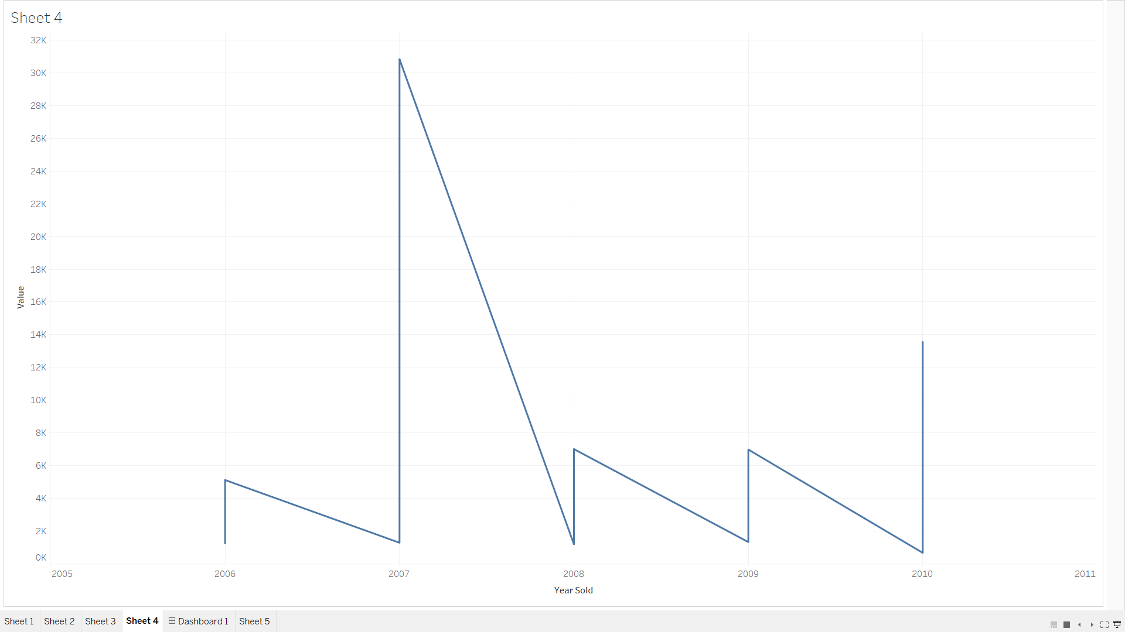

Slide 11
